Slide 1


Transformer Architectures for Biometric Analysis
EE622: Advanced Biometrics
Week 1 Lecture
Summer 2025
Aaron W. Storey
Notes:
Welcome to Week 1 , today we will be starting with Transformer Architectures in Biometrics, exploring how transformer models, originally developed for natural language processing, have revolutionized biometric analysis.
These architectures offer a unified approach across different biometric modalities—from faces to fingerprints, iris patterns to voice recognition.

Slide 2
Learning Objectives
Understand transformer architecture fundamentals and how they differ from RNNs
Identify key components of attention mechanisms and their relevance to biometrics
Analyze how self-attention captures relationships between biometric traits
Recognize the adaptability of transformers across multiple biometric modalities
Notes:
By the end of today's lecture, you should be able to understand the fundamental components of transformer architectures and articulate how they differ from traditional RNNs.
You'll identify the key components of attention mechanisms and explain their relevance to biometric analysis.
We'll analyze how self-attention captures relationships between biometric traits, which is crucial for recognition tasks.
Finally, you'll recognize how transformers can be adapted across multiple biometric modalities, providing a unified framework that previous approaches lacked.
Our terminal learning objective is for you to explain transformer applications in biometrics and implement attention visualization that I will demonstrate in today’s lab.

Slide 3
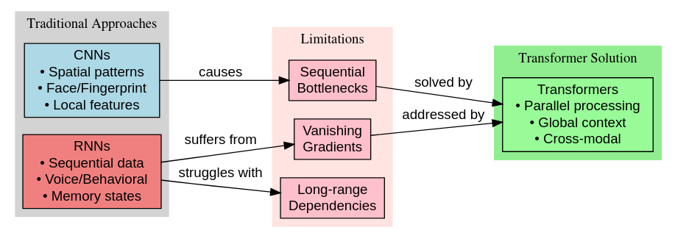
Evolution of Neural Networks
Traditional: CNNs for spatial data, RNNs for sequential data
Limitations: Sequential computation, vanishing gradients
Need for: Parallel computation, global context, cross-modal adaptability
Notes:
Let's begin with the evolution of neural architectures leading to transformers.
Traditional approaches to biometric analysis relied on specialized architectures for each modality.
Convolutional Neural Networks excelled at extracting spatial patterns from image-based biometrics like faces and fingerprints, while
Recurrent Neural Networks handled sequential data like voice patterns. However, they suffered from fundamental limitations: they process data sequentially, one element at a time, creating computational bottlenecks.
They struggled with the vanishing gradient problem, making it difficult to capture long-range dependencies. As biometric systems needed to process more complex patterns, these limitations became increasingly problematic.
The timeline shows this evolution from specialized architectures to the unified transformer approach. The key insight was that we needed parallelizable architectures capable of capturing global context across all elements simultaneously—exactly what transformers provide. This shift represents a fundamental rethinking of how neural networks process biometric data.

Slide 4
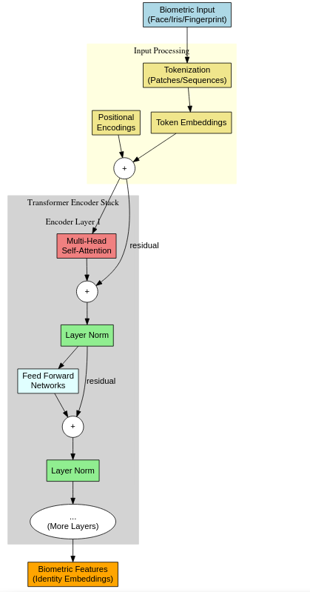
The Transformer Architecture
Key Innovations: Encoder-decoder structure, parallel processing, self-attention
Architecture: Multi-head attention, feed-forward, residuals, normalization
Notes:
Here we see the landmark transformer architecture introduced by Vaswani and colleagues in their 2017 paper "Attention Is All You Need." The architecture consists of an encoder-decoder structure, though for many biometric applications, we often use only the encoder component.
The key innovation lies in how transformers process information. Unlike RNNs that analyze sequential inputs one at a time, transformers process all elements in parallel, significantly speeding up computation. The self-attention mechanism, which we'll examine in a moment, replaces recurrence by directly modeling relationships between all elements.
This architecture offers remarkable modular design, with identical blocks stacked together, making it adaptable to different biometric data types. If you notice each layer contains self-attention followed by feed-forward networks, with residual connections and layer normalization maintaining gradient flow.
The architecture's strength lies in its simplicity and scalability—the same basic structure works across modalities because it operates on abstract token representations rather than raw inputs.

Slide 5
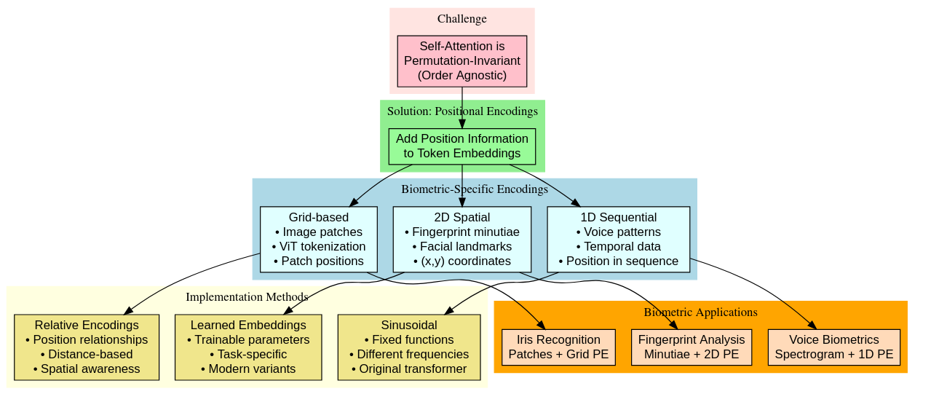
Positional Encoding
Need to encode sequence/spatial order
Types: 1D (voice), 2D (fingerprint), grid (images)
Notes:
One of the biggest challenges with self-attention is that it's inherently permutation-invariant—it doesn't consider the order or spatial arrangement of elements. This poses a problem for biometric data where spatial relationships are crucial.
The solution comes through positional encodings—learned or fixed vectors added to input embeddings to inject spatial or sequential information. In the original transformer, these are sinusoidal functions with different frequencies.
In biometric applications, we adapt positional encodings to the specific data type: For sequential data like voice patterns, we use standard 1D positional encodings based on position in the sequence. For spatial data like fingerprint minutiae or facial landmarks, we incorporate 2D positional information to preserve spatial relationships. For image-based biometrics processed through Vision Transformers, we use grid-based positional encodings based on patch position.
The visualization shows patterns of these positional encodings—notice how they create unique signatures for different positions while maintaining consistent relationships between neighboring positions, which helps the model understand spatial arrangements in biometric patterns.

Slide 6
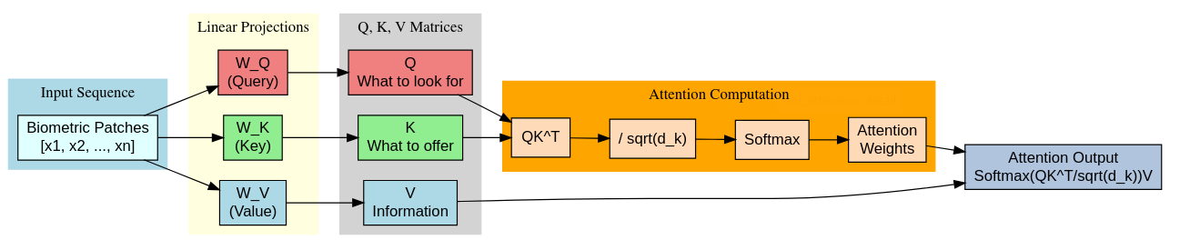
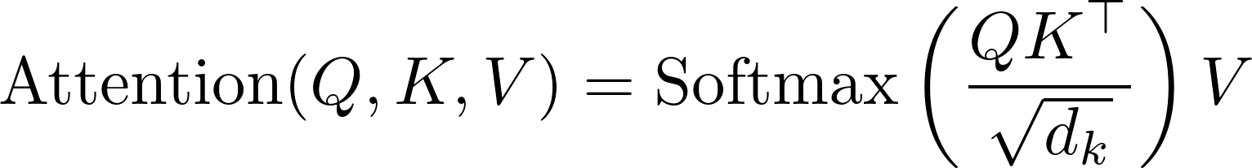
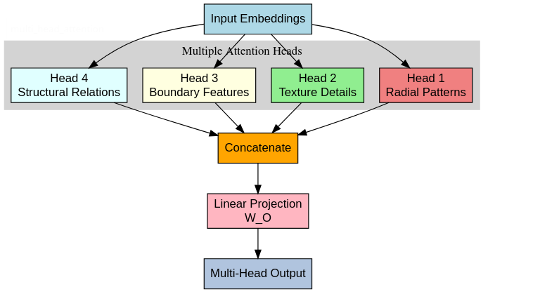
Self-Attention Mechanism
Q, K, V roles explained
Formula:
Multi-head attention enables multi-scale feature analysis
Notes:
Self-attention is the transformative innovation that enables transformers to excel at biometric analysis.
For each element in our input, we create three vectors through learned linear projections: Query, Key, and Value vectors. These vectors serve different roles in the attention calculation. The Query represents what the current element is "looking for," the Key represents what other elements "offer," and the Value contains the actual information to be aggregated.
Attention weights are calculated using the formula shown: Softmax(QK^T/√d_k)V. This means we compute dot products between the Query vector of one element and the Key vectors of all elements, scale by the square root of the key dimension, apply softmax to get a probability distribution, and then use these weights to create a weighted sum of the Value vectors.
The multi-head attention mechanism runs this process multiple times in parallel with different learned projections. This allows the model to jointly attend to information from different representation subspaces at different positions—critical for biometric analysis where features exist at multiple scales and relationships.
The visualization shows this process applied to biometric data, where attention helps the model focus on identity-significant features while contextualizing them with surrounding information.

Slide 7
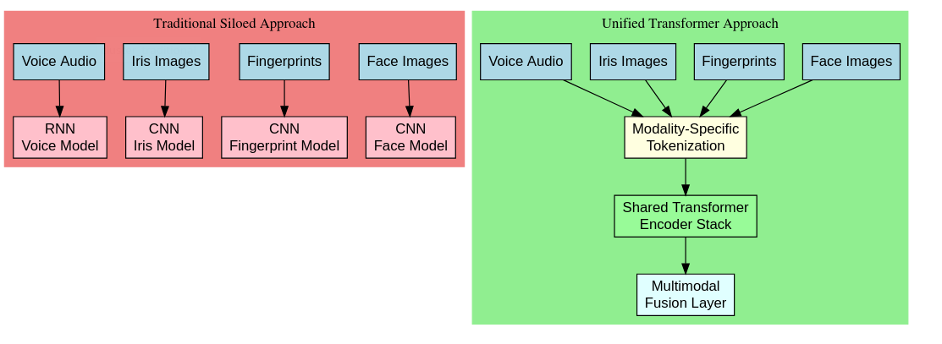
Unified Architecture
Transformer applies across modalities via tokenization
Shared transformer backbone for all biometric types
Simplifies system design and enables knowledge transfer
Notes:
A fundamental advantage of transformers is their unified architecture across biometric modalities. Traditional approaches required specialized architectures for different biometrics: CNNs for image-based data like fingerprints, faces, or iris patterns; RNNs or LSTMs for sequential data like voice; and often custom feature extractors for each modality.
Transformers change this paradigm by offering a single architectural backbone adaptable across modalities. The key insight is that while tokenization—converting raw biometric data into abstract representations—may be modality-specific, the subsequent processing pipeline remains consistent. This enables knowledge transfer across modalities and simplifies system integration for multimodal biometrics.
The diagram contrasts traditional siloed architectures with the unified transformer approach. Notice how the transformer pathway processes different input types through specialized tokenization but identical transformer blocks—dramatically simplifying system design while improving performance through cross-modal learning opportunities.

Slide 8
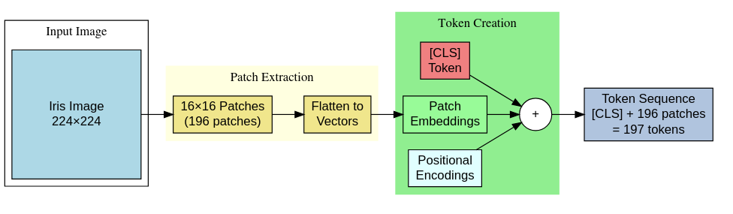
Feature Extraction
ViTs pre-trained and fine-tuned for biometric tasks
Attention captures fine details and modality-invariant features
Notes:
Let’s take a quick look at how Pre-trained Vision Transformers (ViT) serve as powerful feature extractors for image-based biometrics. These models, trained on large datasets like ImageNet, learn generalizable visual representations that transfer well to biometric tasks.
Cross-spectral vision transformers address a significant challenge in biometrics: matching samples across different sensing modalities, like visible light versus infrared images of the same face. The self-attention mechanism helps identify modality-invariant features while suppressing modality-specific variations.
Transformers enable fine-grained recognition by capturing subtle distinguishing features through their attention mechanisms. The global context provided by transformers helps correlate distant features—critical in biometrics where identity information is distributed across the sample.
The visualization shows feature maps extracted by transformers from biometric samples. Notice how they capture increasingly abstract representations while preserving identity-critical information, demonstrating the transformer's ability to focus on discriminative features regardless of position or appearance variations.

Slide 9
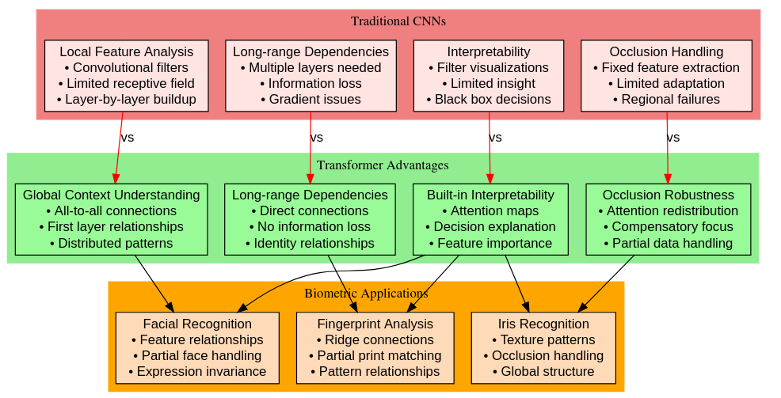
Transformer Advantages
Global vs local analysis, long-range dependencies
Occlusion robustness and interpretability via attention maps
Notes:
Transformers offer several key advantages over traditional biometric methods. First, they provide global context understanding versus local feature analysis. While CNNs excel at extracting local patterns through convolutional filters, they struggle to model long-range dependencies without multiple layers. Transformers capture global relationships from the first layer through self-attention.
This enables transformers to capture long-range dependencies in biometric patterns—critical for identifying distributed features that collectively determine identity. For example, the relationship between facial features rather than the features themselves often distinguishes individuals.
Attention visualization offers built-in interpretability—we can directly examine which parts of the input influence the model's decisions, providing insights into the biometric recognition process.
Transformers also handle occlusions and partial data more effectively because their global attention mechanism can compensate for missing information by leveraging available features differently.
The comparison shows attention maps from CNNs versus transformers on the same biometric sample. Notice how CNN attention is localized to specific regions, while transformer attention captures distributed patterns and relationships across the entire sample.

Slide 10
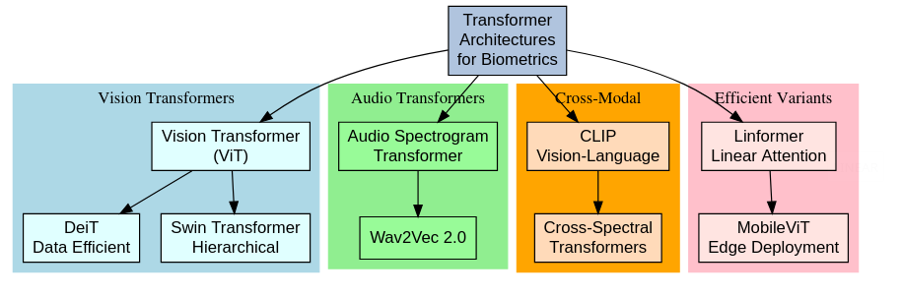
Transformer Variants
ViT (image), Audio transformers (voice), Cross-modal transformers (fusion)
Efficient variants for deployment
Notes:
Let's explore key transformer variants adapted for different biometric modalities. Vision Transformers (ViT) have revolutionized image-based biometrics by treating images as sequences of patches. These work exceptionally well for face, fingerprint, and iris recognition by capturing global relationships between image regions.
Audio transformers adapt the architecture for voice biometrics by tokenizing spectrograms or waveforms. These models capture temporal patterns while maintaining global context across the entire utterance.
Cross/Multi-modal transformers extend the architecture to handle multiple biometric modalities simultaneously. They use modality-specific tokenization followed by cross-attention mechanisms that learn relationships between different biometric signals.
Efficient transformer variants address deployment concerns by reducing computational requirements through techniques like sparse attention, low-rank approximations, and knowledge distillation.
The taxonomy shows how these variants relate to each other and their biometric applications. This diversity of approaches demonstrates the flexibility of the transformer architecture while maintaining its core self-attention concept across implementations.

Slide 11
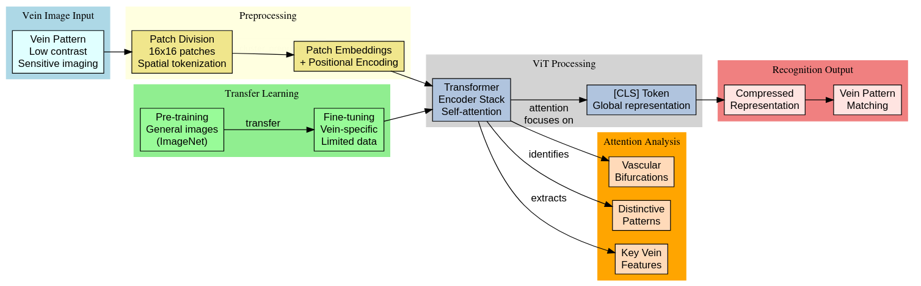
Case Study: Vein Recognition
Patch-based ViT for vein patterns
Good performance on limited data
Attention reveals key features like bifurcations
Notes:
Let's examine a concrete application: Vision Transformers for vein biometric recognition. Vein patterns offer secure biometric identification as they're internal to the body and difficult to spoof, but they present challenges due to low contrast and sensitivity to imaging conditions.
The architecture shown adapts Vision Transformers for this task. It divides vein images into patches, processes them through transformer encoders, and produces a compressed representation for matching. The unique aspect is how pre-training is handled—the model is first trained on a large dataset of general images, then fine-tuned specifically on vein images.
What's remarkable is the performance on limited training data. Traditional CNN approaches require substantial vein samples, but transformer models leverage transfer learning to achieve superior performance with fewer samples—a critical advantage in biometrics where collecting large datasets is often impractical.
The attention visualization reveals how the model focuses on vascular bifurcations and distinctive pattern regions, demonstrating an ability to identify the most discriminative features automatically.

Slide 12
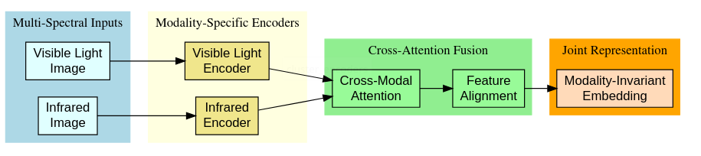
Case Study: CS-ViT
Cross-spectral transformer for modality-invariant matching
Consistent performance across sensing domains
Attention maps show anatomical feature focus
Notes:
Our second case study examines Cross-Spectral Vision Transformers (CS-ViT) for biometric authentication across different sensing modalities. This addresses a common practical challenge: matching biometric samples captured under different conditions, like visible light versus infrared.
The architecture incorporates specialized cross-attention mechanisms that learn correlations between different spectral domains. By processing multiple spectral inputs simultaneously, the model identifies modality-invariant features while suppressing spectrum-specific variations.
Performance comparisons with traditional methods show significant improvements in cross-spectral matching accuracy. While conventional approaches see substantial performance drops when matching across spectral domains, CS-ViT maintains consistent accuracy.
The attention visualization reveals particularly interesting insights: it shows how the model attends to the same underlying anatomical structures despite their different appearances across spectral domains. This demonstrates the transformer's ability to discover invariant biometric features—a capability that traditional architectures struggle to achieve without explicit guidance.

Slide 13
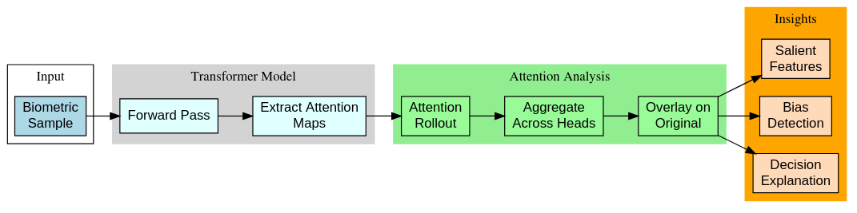
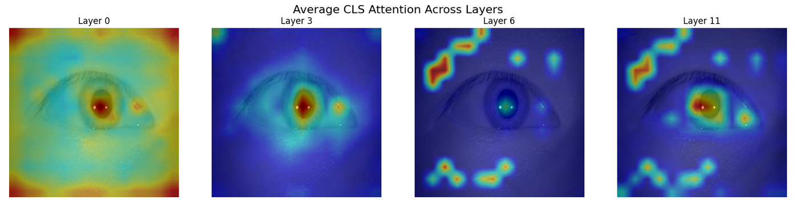
Visualizing Attention
Attention rollout shows feature importance
Used for explainability, bias detection, and security
Notes:
Attention visualization is a powerful tool for understanding how transformers process biometric data. Attention rollout techniques aggregate attention weights across layers to provide global interpretation of how information flows through the model. This helps identify which input elements most influence the output.
Through attention visualization, we can identify salient biometric features—the regions or patterns that most strongly influence identity decisions. This often reveals that transformers learn to focus on the same distinctive features that human experts would use, but can also discover novel discriminative patterns.
Attention patterns can also be used for explainability in biometric decisions, addressing the "black box" concerns often raised with deep learning systems. When a biometric system rejects or accepts an identity claim, attention visualization can help explain which features influenced that decision.
Analyzing attention across demographic groups provides insights into potential biases in biometric systems. Different attention patterns across groups might indicate inequitable feature importance, helping identify and mitigate biometric fairness issues.
The examples show attention visualizations across different biometric samples, revealing how attention targets identity-distinctive features that vary across individuals.

Slide 14
Summary
Transformers = Unified, interpretable, global context models for biometrics
Applications: feature analysis, multimodal fusion
Future: Specialized architectures, privacy enhancements
Notes:
To summarize our key takeaways: Transformers provide a unified architecture for biometric analysis through their parallel processing and global context understanding. This represents a significant advancement over traditional approaches that required modality-specific architectures.
The core advantages include the ability to capture long-range dependencies, interpretable attention mechanisms, and cross-modal adaptability. These properties make transformers particularly well-suited for biometric applications where relationships between features often matter more than the features themselves.
In practice, attention visualization offers a powerful tool for analyzing how transformers process biometric data, providing insights into feature importance and potential biases.
Looking forward, we anticipate specialized transformer architectures optimized for specific biometric tasks, efficiency improvements for deployment on resource-constrained devices, and enhanced privacy-preserving techniques.
As we move to the lab component, you'll directly implement attention visualization techniques to gain hands-on experience with these concepts.

Slide 15
Discussion
Human-like focus in attention?
Transformers across demographics?
Security via visualization?
Resource-constrained deployment?

Slide 16
Lab
Hands-on with attention maps in ViTs
Compare patterns across modalities and layers
Identify biometric features via attention

Slide 17
Preview
Focus: Fingerprint transformers, minutiae, and ridge flow
Hybrid CNN-transformer architectures
Notes:
Next week, we'll build on these foundational concepts to explore transformer models specifically for fingerprint feature extraction. We'll examine how self-attention mechanisms can identify and process minutiae points and ridge patterns, and how hybrid CNN-transformer architectures leverage the strengths of both approaches.
The visualization teases some of the attention patterns we'll explore, showing how transformers attend differently to core points, bifurcations, and ridge endings in fingerprint analysis. The lab will provide hands-on experience implementing these fingerprint-specific transformer applications.
Please review the resource links provided for deeper exploration of today's concepts. The primary papers are essential reading, particularly Vaswani's original transformer paper and the recent applications in biometrics. The supporting resources provide excellent visualizations and tutorials that will help solidify your understanding.
Now, let's transition to our lab session where you'll implement attention visualization techniques to see these concepts in action.

Slide 18
Resources
Vaswani et al. (2017), Dosovitskiy et al. (2020)
IEEE & arXiv papers
Illustrated Transformer, Hugging Face docs

